Slide 1
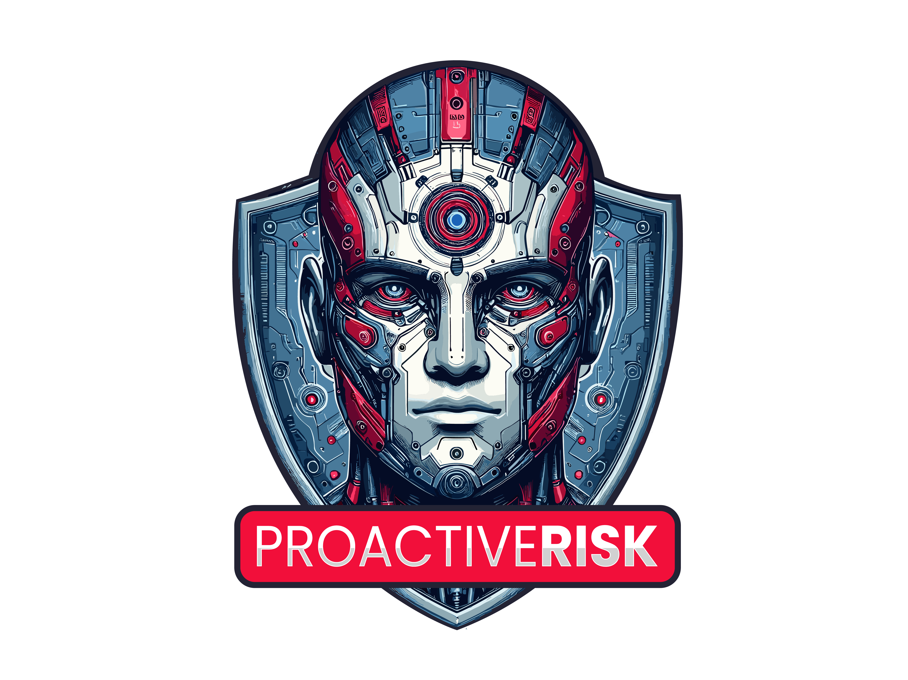
973-298-1160 www.proactiverisk.com
Shifting Gears
Offensive Solutions for Modern Cybersecurity Challenges

Slide 2
Onboarding Priorities
Initial Onboarding Design
  Main focus is proactive reliability
  Reduce risk of downtime due to lack of reliability
  Focus on scalability and growth
  Includes defensive level security
It's time to do the same with security and refocus efforts on offensive solutions
DEFENSIVE SECURITY
Endpoint Detection & Response (EDR)
Email Filtering
Built-In Email Alerting

Slide 3
In the News
MGM Attack
  September 2023
  Sophisticated and targeted attack
  Used various tradecraft methods layered on top of each other
  Threat actors are pivoting to attacking SSO
  Result: Systems down, causing a reported $8.4 million dollar loss of revenue per day.
ATTACK TIMELINE
Hackers gather intel about MGM employees
Identify targets through LinkedIn
Perform vishing (voice phishing) attack
impersonating the target, convincing IT to reset the MFA of the user
Compromise the Okta admin account to access more admins
Exfiltrate sensitive data from the network
Encrypt 100 ESXi servers and all VMs that run on top of them
Notes:
This slide is to grab attention and relate to the viewer with something in the media.
This is what we are seeing – high profile breach. Even the most secure and financially supported is vulnerable but we know this is not just an enterprise problem.

Slide 4
SMBs are at higher risk of attack
47%
43%
60%
43%
96%
47% of businesses with less than 50 employees do not have a dedicated cybersecurity budget, making them
more vulnerable to cyber threats.
43% of attacks are aimed at SMBs. Only 14% of these businesses are prepared to defend themselves.
60% of small businesses that suffer a cyberattack go out of business within six months.
Small businesses are target #1 for criminals and represented 43% of all data breaches
96% of attacks across all organizations focuson monetary gain, but this drops to 71% for larger organizations
Corvus Insurance
Accenture
Verizon
Verizon
Verizon
Notes:
This isnt just affecting enterprise – scary stats from SMBs.

Slide 5
Attack Tactics are Evolving
SMBs SEE
ENTERPRISE TACTICS
Target businesses & their critical infrastructure
The goal is to cause widespread disruption, financial loss, & reputational damage
ADVANCED EVASION TECHNIQUES
Evade EDR security measures through:
file-less malware
legitimate IT tools
deploying tactics to bypass detection
SPEED & AUTOMATION
Advanced techniques:
Operators now favor speed over stealth as certain detection technologies made speed more effective
ENCRYPTION
Newer encryption methods now focus on speed instead of stealth
Criminals will also target backups and other recovery methods
RANSOMWARE-AS-A-SERVICE
(RaaS)
As new variants are created, they are leased to other operators
Significantly lowers the barrier of entry for hackers
COLLABORATION
Formation of ransomware groups that share tools, techniques, and intelligence
The human element is the most common threat vector; it was the root cause of 82% of data breaches, according to Verizon's "2022 Data Breach Investigations Report." The human element especially plays a role in phishing attacks and stolen credentials. Phishing is often delivered via email; these attacks trick a user into clicking a link or providing information that can lead to exploitation.
Notes:
Attacks have evolved to focus on speed and stealth. Going from one tactic to multi tactic approaches with people.
Back then malware was the colperit but now it has evolved into malware & tradecraft

Slide 6

INSPIRED BY NIST CYBERSECURITY FRAMEWORK
Best Practices in Security
THE FIVE MAIN PILLARS OF DEFENSE AND RESILIENCY
1
2
3
4
5
Visibility
Attack Surface Reduction
Early Threat Detection
Real-Time Response
Incident Recovery
LEFT OF BOOM
RIGHT OF BOOM
Identify what needs to be protected.
For example, devices, operating systems, patch level, and installed applications.
Reduce the attack surface through MFA, the principle of least privilege, and no DMZ.
Detect malicious applications and
live-off-the-land hacker tradecraft.
Operate with an “assume breach” mentality. Detect and thwart malicious cyber intrusions before the adversary reaches their objective, such as data theft or ransom.
Recovery includes DFIR, Backup / Disaster Recovery, Breach Council, Cyber Insurance, etc.

Slide 7


Moving from EDR to TRUE MDR
MALWARE
TRADECRAFT
Key tactic 80's – early 2000s
Uses software to gain unauthorized access to devices
Caught by AV & EDR solutions
Easier to detect
Example: Virus, Worm, Trojan, spyware, etc.
Introduced mid-2000s and is evolving
Uses everyday, built-in device tools
Does not follow a standard attack sequence
Harder to detect due to sophisticated & customizable techniques
BASIC EXAMPLE
For example, an attempt to access an admin share would not be caught by malware because it looks like benign behavior.
Notes:
Advanced security solutions and legacy tools, such as AV and EDR, may be able to catch malware, but are unable to detect advanced techniques, requiring the expertise of live security analysts.
14% vs. 86%
It's not just about ransomware:
Tradecraft detection is a key differentiator
Defenders must operate with an information asymmetry advantage
In this age, you can't leave your customer's security to automated security solutions or legacy tools
Double extortion ransomware:
Rising popularity of double extortion ransomware
Not just encrypting files, they exfiltrate the data first – if the victim doesn't pay the ransom, info is leaked online or sold to bidders
This renders backups and data recovery plans worthless
Sensitive information may still be available to the public
Threat 1: Steal Data. Threat 2: Make Public.

Slide 8
Defensive Security vs Offensive Security
DEFENSIVE SECURITY
OFFENSIVE SECURITY
Endpoint Protection
24/7 Human-led MDR
Email Filtering
Endpoint Protection
Cloud Protection
Built-In Email Alerting
Real-Time Ransomware Response
Malware Protection
Malicious Application Blocking
Vulnerability Awareness
Notes:
In the past you only needed xyz but to stand up against the evolving tactics, your stack must be robust.

Slide 9
Meet The Purpose-Built
Full Coverage Security Offering
COVER THE FIVE MAIN PILLARS OF DEFENSE AND RESILIENCY
1
2
3
4
5
Asset Visibility
Network Hardening
Threat Detection
Real-Time Response
Incident Recovery
LEFT OF BOOM
RIGHT OF BOOM
Complete Network Visibility
Cloud Protection
Live Detection for On-Premises
Live 24/7 Response
BCDR
Vulnerability Visibility
Compliance Reporting
Live Detection in the Cloud
Live 24/7 Response for the Cloud
Cyber Insurance
Vulnerability Reporting
Application Protection
Application Blocking
Threat Intelligence Reporting
Select Integration Protection
Alert Management
Real-Time Threat Isolation
Notes:
With these 5 key, agnostic pillars of security, you address 75% of what you need for defense and depth methodology.

Slide 10






COMPREHENSIVE PROTECTION
True
Security
Bundle
Modern Streamlined Cyber Stack
Active Response
Endpoint Tradecraft Protection
Cloud Tradecraft Protection
Real-time Ransomware Response
Identity Tradecraft Protection
Malware Protection
Application Control
Multi-Tenant Policy Management
Vulnerability Management
OUTSOURCED DEDICATED TEAMS
SOC Analyst
Threat Hunter
Threat Research
Notes:
Efficient Protection
These are all of the components needed to properly secure an environment without overlap or unnecessary tooling.
Comprehensive
24x7 coverage with threat hunting capabilities that immediately take action to prevent a compromise from becoming a breach.
Scalable
A single, unified tech-stack purpose-built to detect and respond to advanced threats combined with 24x7 human expertise can scale alongside a growing business and the constantly-changing threat landscape.

Slide 11








Meet [Partner Name] Purpose-Built
SOCaaS Platform
COVER THE FIVE MAIN PILLARS OF DEFENSE AND RESILIENCY
1
2
3
4
5
Asset Visibility
Network Hardening
Threat Detection
Real-Time Response
Incident Recovery
LEFT OF BOOM
RIGHT OF BOOM
Live Network Mapping
Azure/365 Hardening
Live Detection
Live 24/7 Response
Vulnerability/Hygiene Reporting
Compliance Mapping/Reporting
Live Detection (Azure/365)
Live 24/7 Response
Credential Breach Identification
Curated Zero Trust
Curated Zero Trust
Vulnerability/Hygiene Reporting
Integrated & Orchestrated AV/EDR
AV/EDR Alert Management
Threat Intelligence Reporting
Multi-Tenant Policy Management​
Automated, Real-time Detainment
Live 24/7 Response
Live 24/7 Response
Notes:
With these 5 key, agnostic pillars of security, you address 75% of what you need for defense and depth methodology.

Slide 12
The Result of Partnership
True security built for business success.
1
2
3
OFFENSIVE SECURITY
Proactive security solutions that cover your attack surface
DEDICATED TEAMS
Team of security professionals with 24/7 eyes on your devices
PARTNER IN SUCCESS
A partner equally invested in the security and success of your business.
Cyberthreats keep evolving. Sleep better at night knowing your security tech is proactively evolving to combat future threats.

Slide 13
973-298-1160
www.proactiverisk.com

